Slide 1
SYRACUSE UNIVERSITY
2024
DETECTING AND MITIGATING
TOXIC COMMENTS IN ONLINE PLATFORMS
USING TOXIC-BERT AND TOPIC MODELING
Mervin McDougall, Marina Mitiaeva, Lakshmi Peram, Nick DeVita
group #1

Slide 2
Project Overview
Problem
Solution
2/3 of moderation remains manual, overwhelming unpaid moderators
automate high-risk topic detection with NLP to ease the burden and decrease maintenance costs
limited NLP moderation focuses mainly on reactive tools (harassment detection)
deploy proactive NLP for early toxic content detection
poor moderation affects user experience, advertiser trust, and platform sustainability
identify and mitigate toxic threads early to protect stakeholders

Slide 3
Our Stakeholders
Reddit Users
Ensures safer and healthier interactions
Moderators
Reduces manual workload and improves efficiency
Shareholders
strengthens platform sustainability post-IPO
Advertisers
Protects brand safety by fostering a well-moderated environment

Slide 4
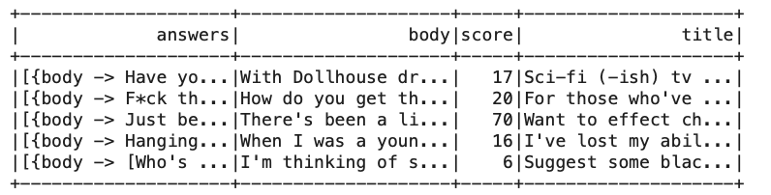
Data Overview
Sample Size:
50,000 rows sampled from an original dataset of 1,833,556 rows
Key Columns:
- Title: Title of the post
- Body: Main text authored by the original poster
- Answers: Contains responses to the post
- Score: Represents post popularity and engagement
Subject for Analysis:
Thread - a combination of title, body, and answers text, used for topic modeling and further analysis

Slide 5
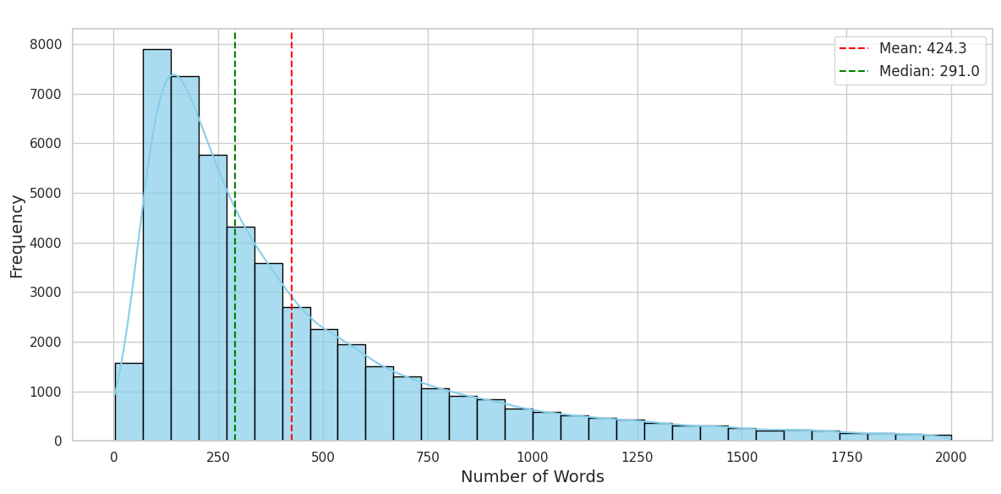
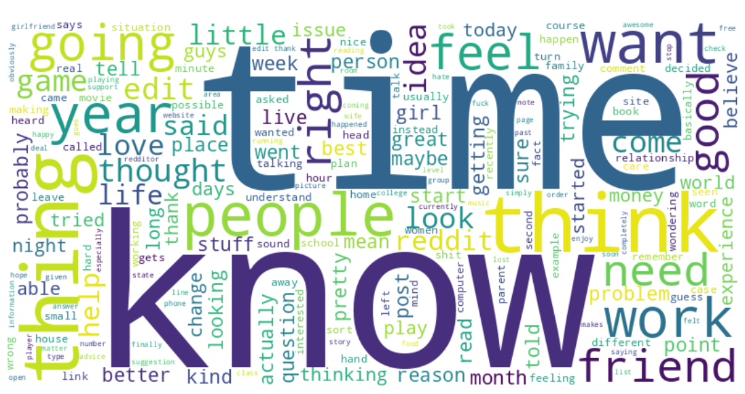
Threads EDA Results
Thread Text Length Analysis for high density region
Body Word Cloud after removal of short and stop words
min | max | 25% | 50% | 75%
3 | 97156 | 162 | 302 | 592
Corpus size: 2,460,750
Unique words: 75,219 ~ 3.06%

Slide 6
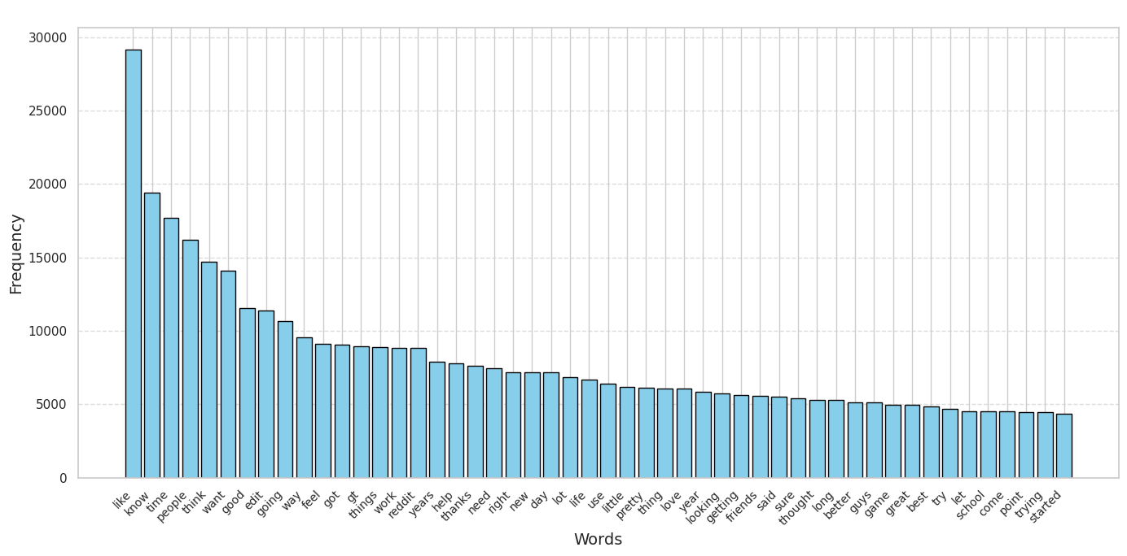
Threads EDA Results
Word Frequency Distribution for Top 50 Words in Body
after non-alphabetic and stop words removal
Count: 405,539
~ 14.91%
Total words: 2,719,348

Slide 7
Methods Used
Topic modeling
1
3
2
Data preprocessing
Toxicity evaluation
Created threads
Removed non-alphabetic characters
Eliminated stop words from all main text columns and added custom stop words
Experimented with word length filtering, but did not apply it in the final preprocessing
Main Stages:
Pipeline (tokenization + vectorization + idf)
LDA model with 5 topics
Topic mapping: assigned top 5 words per topic to document
Used pretrained Toxic-BERT
Input: tokenized data
Output: toxicity score (probability of toxicity for each text)

Slide 8
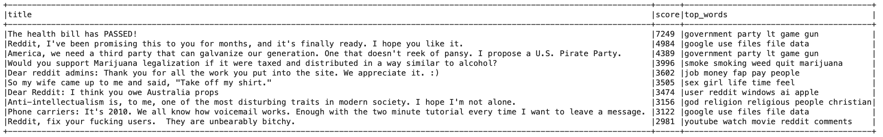
Topic Modeling Results
Number of topics: 20
Vocabulary Size: 2,000
Max Iterations: 10
Overlap: Titles frequently share key terms with their topic tags, demonstrating alignment between generated topics and post themes.
Patterns: Titles grouped under the same topic often discuss similar themes, e.g., "government" or ”party.”
Identical Topics: Repetition arises due to broad, overlapping themes like "government party" or "google data.”
Insights: High-scoring posts tend to reflect popular, general themes, which sometimes reduces topic uniqueness.
Notes:
MIN MAX MEDIAN for score

Slide 9
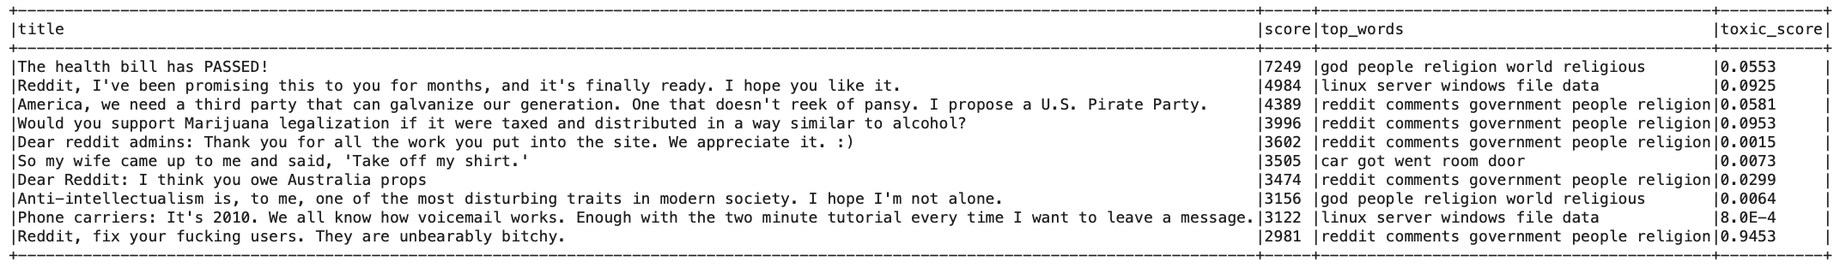
Toxicity Modeling Results
Overview
- model: toxic-bert
- output: the probability of toxic content (0 to 1)
Key Insights: threads with explicit or aggressive language have higher toxicity scores
Next Steps
- Evaluation: incorporate median-based toxicity scores for key topics to understand overall sentiment trends
- Optimization: Integrate distributed pipelines for better scalability
- Focus: Refine features for thread-level analysis and enhance model responsiveness
Challenges
Feature Support: PySpark lacked compatibility for intermediate evaluation; only final scoring was feasible.
Performance: Evaluation was slow on full threads; scope reduced to body text for scalability.

Slide 10
Project Challenges & Key Takeaways
Google Collab Platform Issues
Runtime errors and computational constraints
Data Amount
Managed large-scale 1.8M rows data with strategic sampling
Better preprocessing
Could apply lemmatization, advanced text normalization, and n-gram generation for improved analysis
PySpark Library Limitations
Limited support for advanced NLP tasks and slow iterative transformations
Topic Modeling Interpretations
While topic precision could improve by increasing the number of keywords and using coherence scores, evaluation remains challenging without context
Toxicity Modeling
Applied a pretrained model with a single output, while results could be potentially improved by fine-tuning and using an extended version not supported in PySpark

Slide 11
Future Work Roadmap
Integration with other platforms
GenAI integration
Web Application deployment
Toxicity Logic Improvement
Regression Analysis between Toxicity and Post Scores
Investigate the relationship between toxicity and post engagement scores to uncover trends or patterns
Enhance toxicity detection by integrating additional features and fine-tuning the final classification
Make the project immediately usable by creating a web interface for users to quick analysis
Provide actionable insights for moderators, including decision-making support and automated templates for user responses
Integrate platforms like Slack, Discord, or Reddit for broader use cases

